Slide 1
Logistic Regression
Presented by: Muhammad Zaqeem

Slide 2
Overview
Logistic Regression
Type of Logistic Regression
How Logistic Regression Works
Decision Boundary
Confusion Metrics
Application
Linear Regression vs Logistic Regression

Slide 3
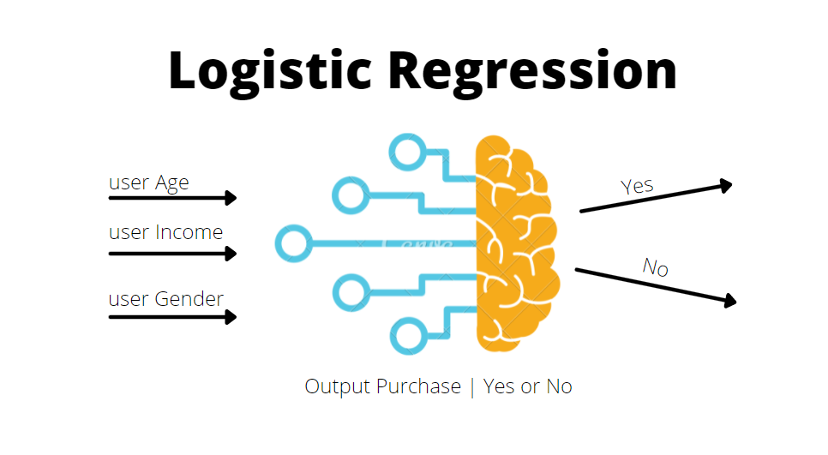
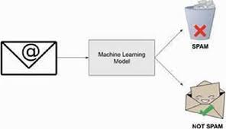
Logistic regression:
Logistic regression is one of the most popular Supervised Machine Learning algorithm
It is used for predicting the categorical dependent variable using a given set of independent variables.
Logistic regression is used for solving the classification problems
it gives the probabilistic values which lie between 0 and 1.
Example:
Classify emails as "Spam (1)" or "Not Spam (0)"

Slide 4
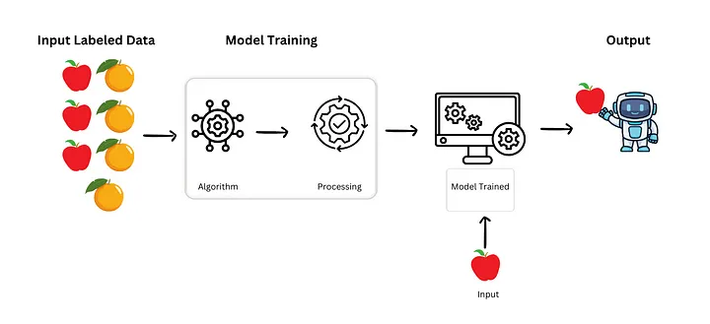
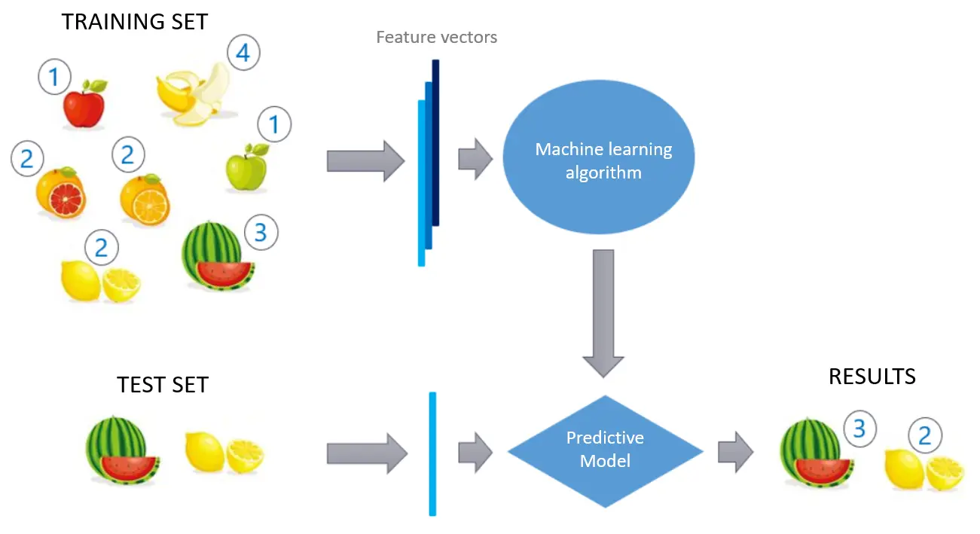
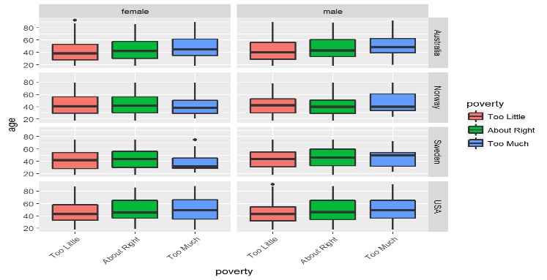
Types of Logistic Regression:
Binary Logistic Regression:
Binary logistic regression is used to predict the outcome of a binary dependent variable based on one or more independent variables.
Multinomial Logistic Regression:
Used when the outcome has more than two classes (multiclass classification).
Ordinal Logistic Regression:
Used when the outcome has ordered categories

Slide 5
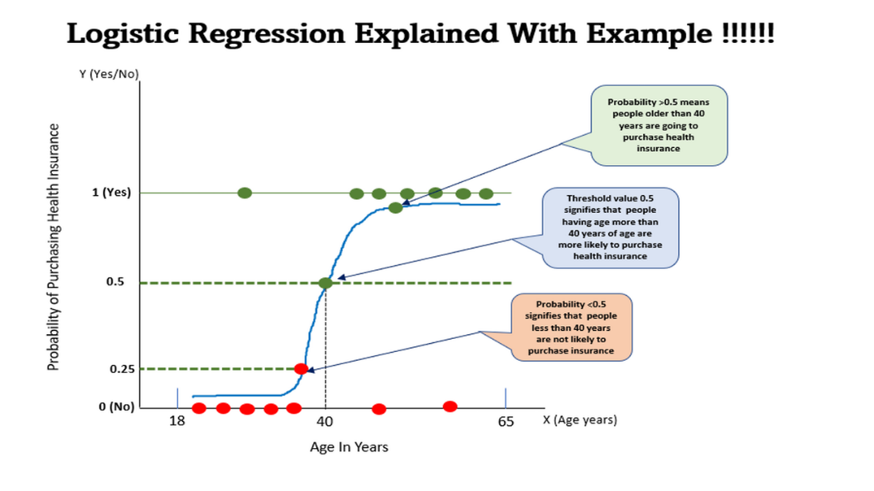
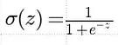
How Logistic Regression Works:
Input Features : Like other machine learning models, logistic regression takes input features (denoted by X) to make predictions. These features can be continuous, categorical, or a mix of both.
Linear Combination of Features: In logistic regression, a linear combination of the input features is computed using weights (coefficients) and a bias term (intercept):
z=mx+b
m is weights (slop)
b is bias or y-intercept
z is the result of this linear combination
Sigmoid Function: logistic regression transforms the result of the linear combination (z) into a probability using the sigmoid function. The sigmoid function ensures that the output is always between 0 and 1.The sigmoid function maps any value of z into a range between 0 and 1, which can be interpreted as a probability

Slide 6
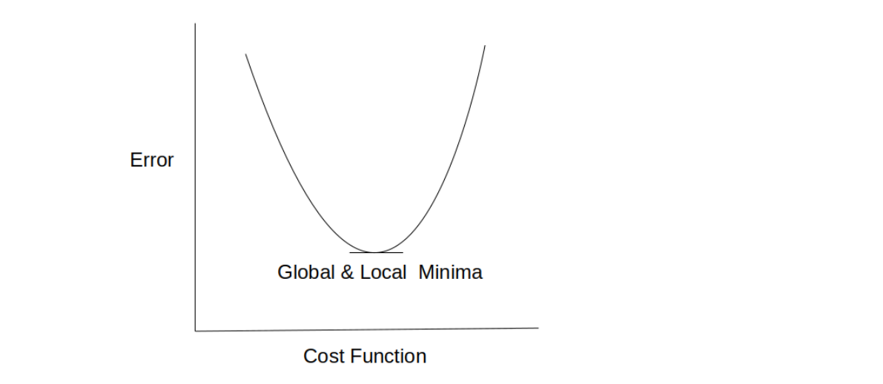

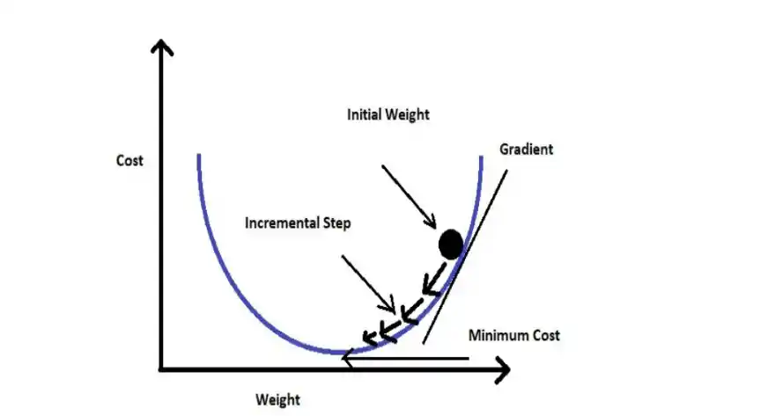
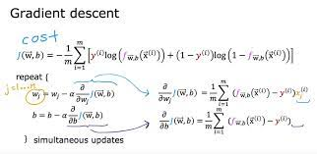
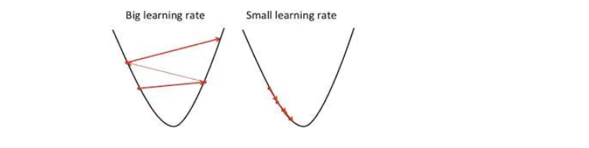
Cont…
Cost function: Logistic regression uses a special cost function called log-loss or binary cross-entropy to measure how well the model is performing.
Gradient Descent: Gradient descent changes the value of our weights in such a way that it always converges to minimum point.
It aims at finding the optimal weights which minimize the loss function of our model.

Slide 7
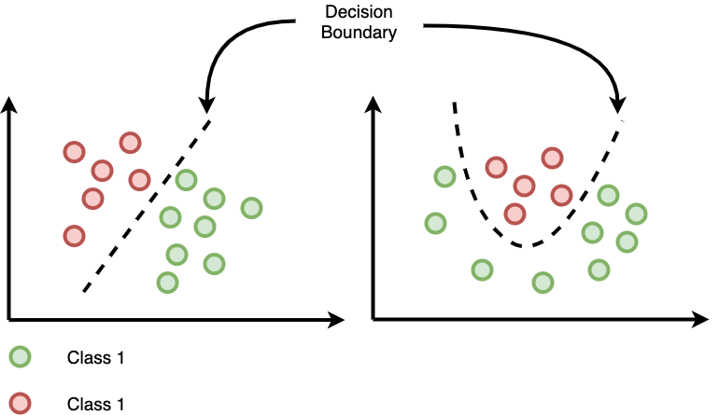
Decision Boundary:
The decision boundary in logistic regression is a boundary that separates the instances of one class from the instances of the other class
It is a line (in two dimensions) or a hyperplane (in higher dimensions)
In logistic regression, the decision boundary is determined by the weights assigned to the input features
The weights control the slope and position of the decision boundary
If the weights are such that the positive class instances have a higher probability

Slide 8
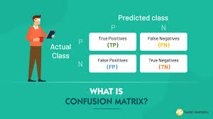
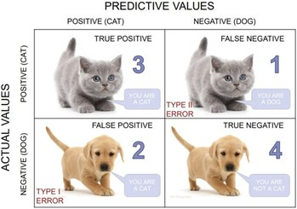
Confusion Metrix:
A confusion matrix is a matrix that summarizes the performance of a machine learning model on a set of test data
It is a means of displaying the number of accurate and inaccurate instances based on the model’s predictions
True Positive (TP): The model correctly predicted a positive outcome (the actual outcome was positive).
True Negative (TN): The model correctly predicted a negative outcome (the actual outcome was negative).
False Positive (FP): The model incorrectly predicted a positive outcome (the actual outcome was negative).
False Negative (FN): The model incorrectly predicted a negative outcome (the actual outcome was positive).

Slide 9
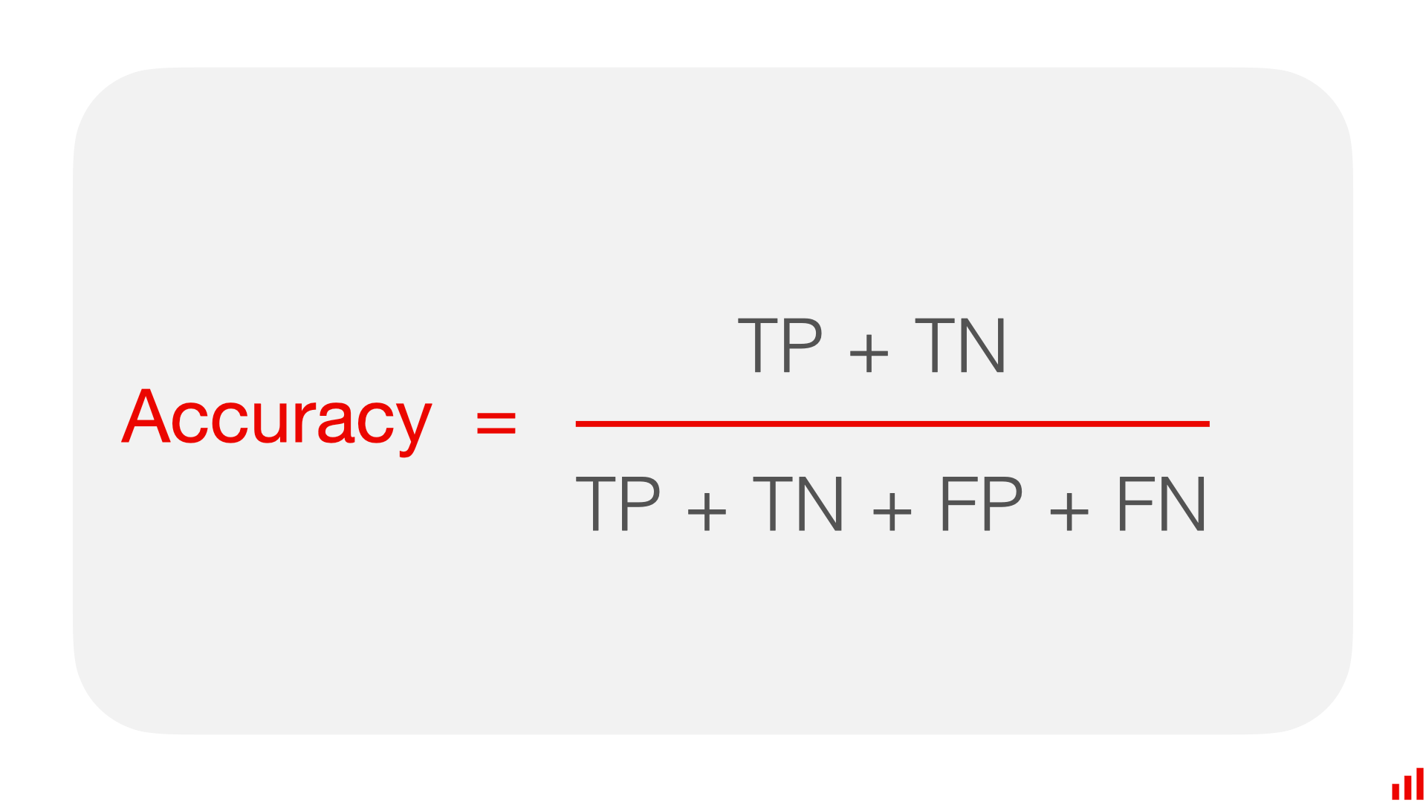
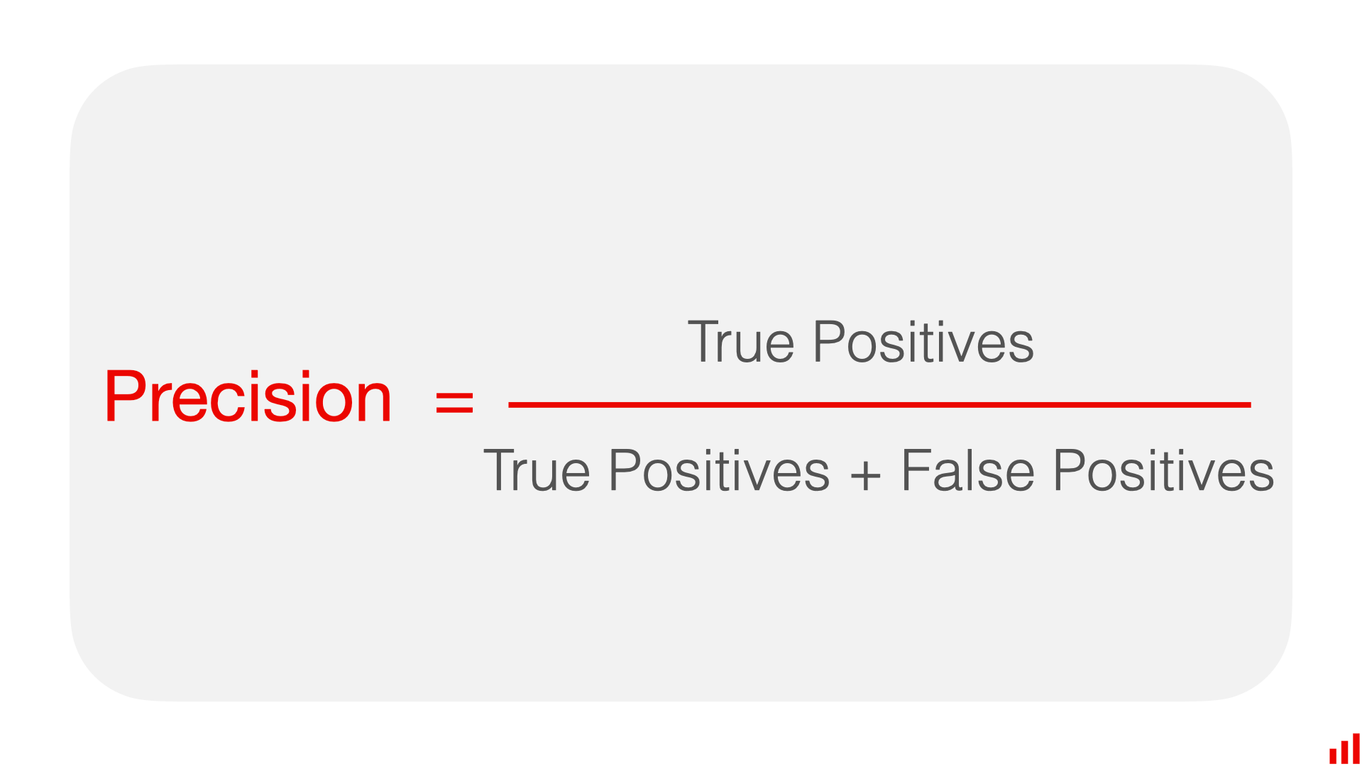
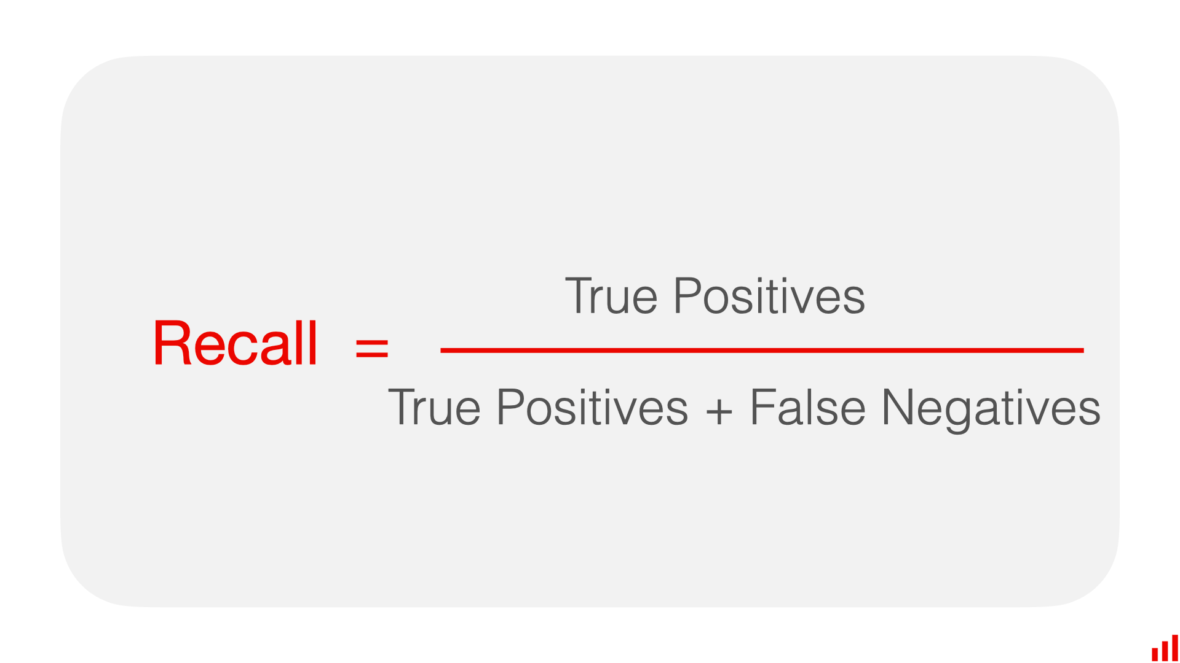
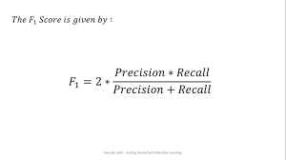
Con…
Accuracy: it measures how often a machine learning model correctly predicts the outcome. You can calculate accuracy by dividing the number of correct predictions by the total number of predictions.
Precision: Precision tells us how many of the correctly predicted cases actually turned out to be positive.
Recall: Recall tells us how many of the actual positive cases we were able to predict correctly with our model.
F1 Score: It is the harmonic mean of precision and recall values. It is maximum when precision is equal to recall

Slide 10
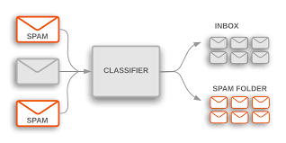
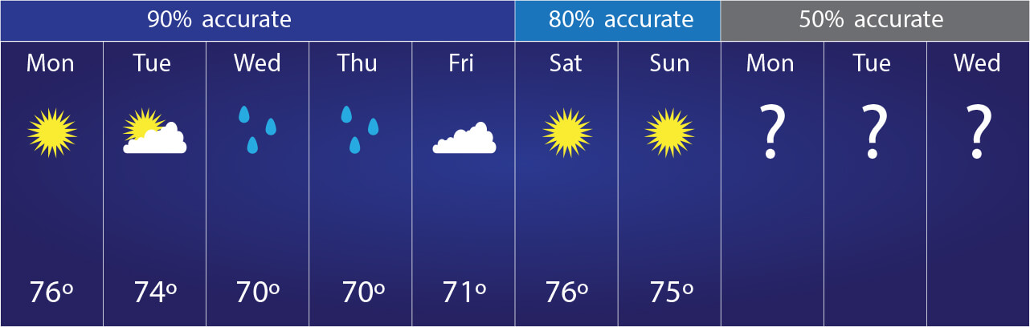
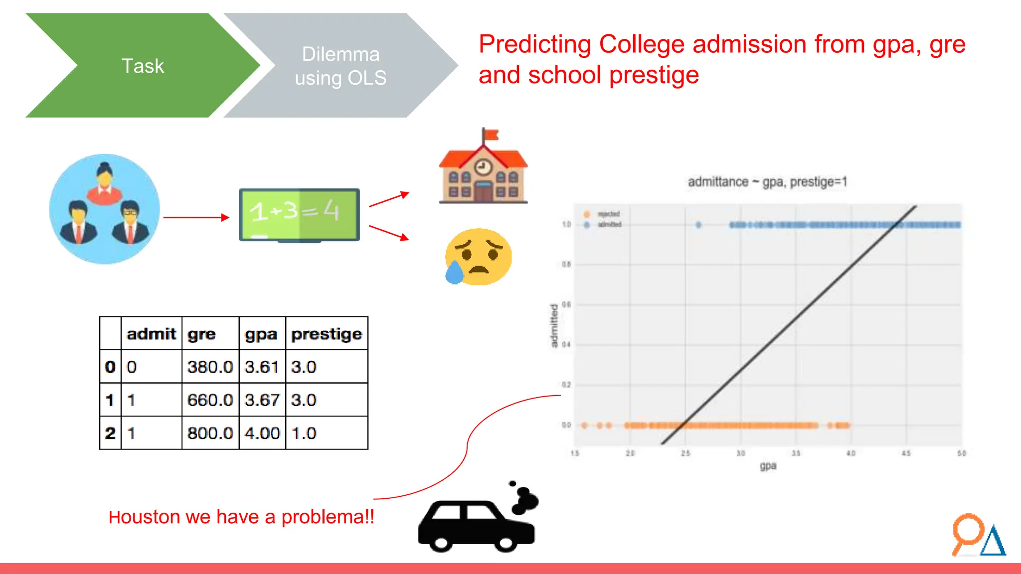
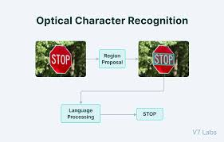
Application:
Medical Diagnosis: Logistic regression is commonly used in medical fields to predict the presence or absence of a disease (binary classification).
Spam Detection: In email filtering, logistic regression is used to classify emails as spam or not spam.
Weather Prediction: Predicting binary weather outcomes like rain or no rain.
Student Admission: Predicting the likelihood of a student getting admitted into a college.
OCR: logistic regression can be used to classify whether a given set of features represents a particular character

Slide 11
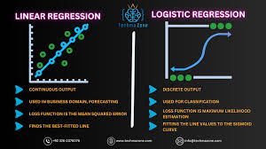
Linear vs Logistic Regression:

Slide 12
Thank You

